Slide 1

SOFT354: Parallel Computation and distributed systems
Week 10
Dr Robert Merrison-Hort

Slide 2
Today’s lecture
More connection topologies for supercomputing.
Torus networks
Fat-tree networks
Class test revision (requested topics):
GPU memory types
Calculating occupancy
CGMA
Speed-up, efficiency, Amdahl and Gustofson’s laws

Slide 3
Today’s lecture
More connection topologies for supercomputing.
Torus networks
Fat-tree networks
Class test revision (requested topics):
GPU memory types
Calculating occupancy
CGMA
Speed-up, efficiency, Amdahl and Gustofson’s laws

Slide 4
Recap: Network topologies
Assume connections are direct – i.e. there is a physical wire (or fibre) between any two connected machines.
How should these connections be organised?
Simplest option is a fully connected network: connect every node to every other node.

Slide 5
Fully connected network
Let’s calculate some properties of this network.
The diameter of the network is the maximum path length between a pair of nodes.
Here all nodes are directly connected, so diameter = 1.
This is the best possible diameter! Higher values can cause latency.

Slide 6
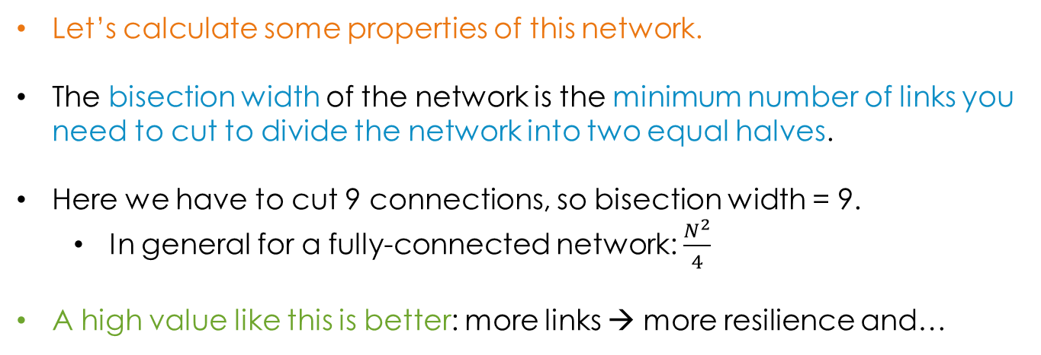
Fully connected network
Let’s calculate some properties of this network.
The bisection width of the network is the minimum number of links you need to cut to divide the network into two equal halves.
Here we have to cut 9 connections, so bisection width = 9.
In general for a fully-connected network: $\frac{N^{2}}{4}$
A high value like this is better: more links → more resilience and…
Notes:
You don’t need to remember the formula for bisection widths of different networks.

Slide 7
Fully connected network
Let’s calculate some properties of this network.
The bisection bandwidth is the bisection width multiplied by the bandwidth of a link.
So in our network, if links were 10GB/s then bisection bandwidth would be 9 * 10GB/s = 90GB/s.
This is relatively high, which is good! Affects the performance of many parallel algorithms.

Slide 8

Fully connected network
Let’s calculate some properties of this network.
The valency is how many connections each node makes.
In this case, each node connects to 5 others, so valency = 5.
In general, for fully connected network, valency = N-1.
A high valency is generally bad – if machines are directly connected then you need this many network ports / cables for each machine.
Maximum (reasonable) number of ports is 6 or 7.

Slide 9
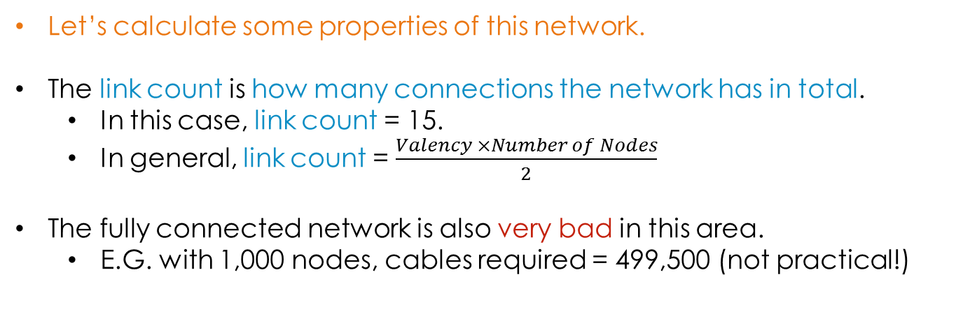
Fully connected network
Let’s calculate some properties of this network.
The link count is how many connections the network has in total.
In this case, link count = 15.
In general, link count = $\frac{Valency ×Number of Nodes}{2}$
The fully connected network is also very bad in this area.
E.G. with 1,000 nodes, cables required = 499,500 (not practical!)

Slide 10
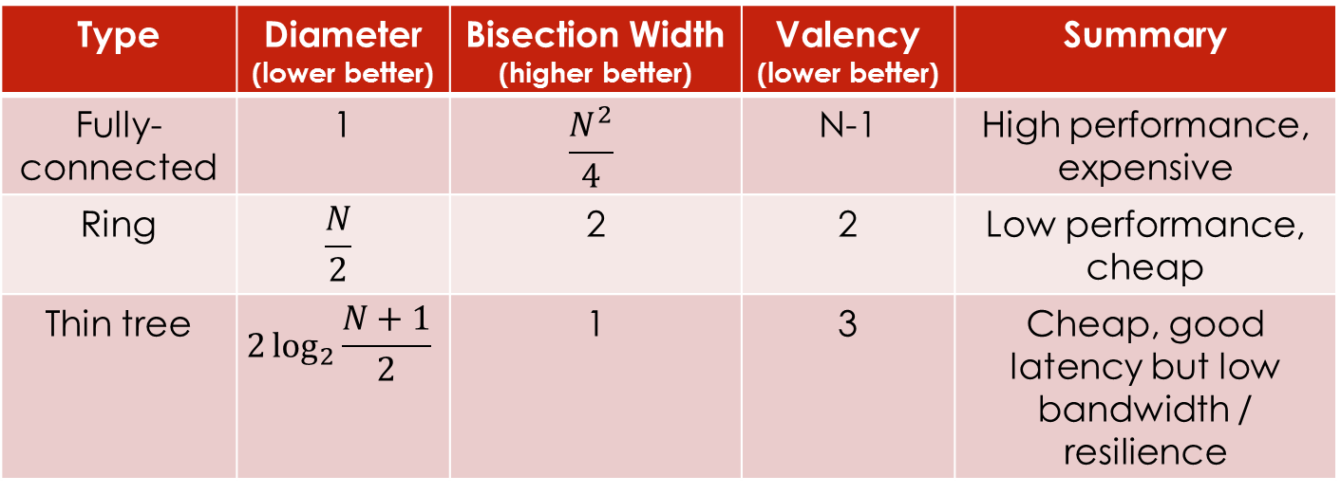
Simple topologies
Last week we looked at three simple topologies:
Type | Diameter (lower better) | Bisection Width (higher better) | Valency (lower better) | Summary
Fully-connected | 1 | $$\frac{N^{2}}{4}$$ | N-1 | High performance, expensive
Ring | $$\frac{N}{2}$$ | 2 | 2 | Low performance, cheap
Thin tree | $$2\log_{2}{\frac{N+1}{2}}$$ | 1 | 3 | Cheap, good latency but low bandwidth / resilience

Slide 11
(2d) Torus arrangement
For simplicity, fix N as a square number. Let’s use N=16.
Arrange nodes evenly in 2D to give a square shape:

Slide 12
(2d) Torus arrangement
Add links between neighbouring nodes.

Slide 13
(2d) Torus arrangement
With wrapping around at the edges…

Slide 14
(2d) Torus arrangement
… both edges!

Slide 15
(2d) Torus arrangement

Slide 16

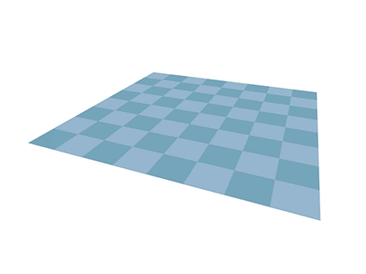
(2d) Torus arrangement
A torus is the same shape as a doughnut.
Imagine the nodes are arranged as a grid on a piece of paper…
Join one pair of edges together to make a tube.
And then join the other pair of edges to make a torus.

Slide 17
(2d) Torus arrangement
What is the diameter (max path length)?

Slide 18
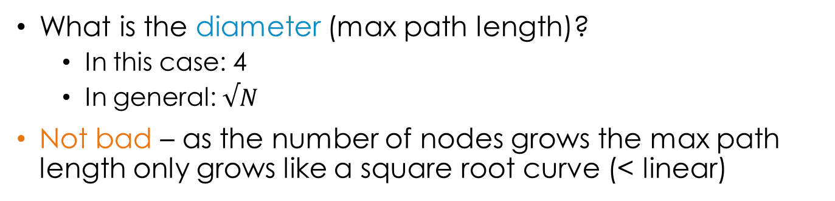
(2d) Torus arrangement
What is the diameter (max path length)?
In this case: 4
In general: $√N$
Not bad – as the number of nodes grows the max path length only grows like a square root curve (< linear)

Slide 19


(2d) Torus arrangement
What is the bisection width, bandwidth?
In this case: 8, 8*Link Bandwidth
In general: 2 $√ N$, 2 $√ N$*Link Bandwidth
Not bad but scale sub-linearly as the number of nodes increases.

Slide 20
(2d) Torus arrangement
What is the valency (number of links for each node)?
In this case: 4 (each node connects to its neighbours)
In general: 4
Great! Doesn’t increase as more nodes are added.

Slide 21

(2d) Torus arrangement
What is the link count?
In this case: 32
In general: $\frac{4N}{2}=2N$
Great! Just need twice as many cables as there are machines.

Slide 22
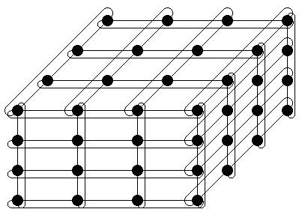
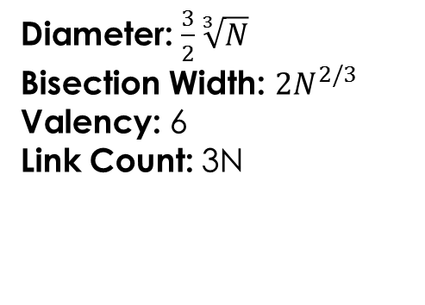
3D torus
It’s possible to construct torus networks that are higher than 2-dimensional.
3D Torus:
Diameter: $\frac{3}{2}\sqrt[3]{N}$
Bisection Width: $2N^{2/3}$
Valency: 6
Link Count: 3N
Better performance than the 2D case, but more expensive (higher valency and link count).
(links / nodes inside the cube not shown)
http://users.ecs.soton.ac.uk/bim/notes/aca/lecture/revise/netrev.html

Slide 23

Higher dimension tori
Torus networks with any number of dimensions (≥2) are possible – but it’s hard to visualise more than 3D!
Generally increasing the dimensionality increases performance, but also increases cost.
IBM Sequoia (Lawrence Livermore National Lab, California)
98,304 nodes (w/ 16 cores each) in a 5-dimensional torus configuration.
Fastest computer in the world in 2012, now 4th.
https://www.top500.org/list/2016/11/?page=1

Slide 24
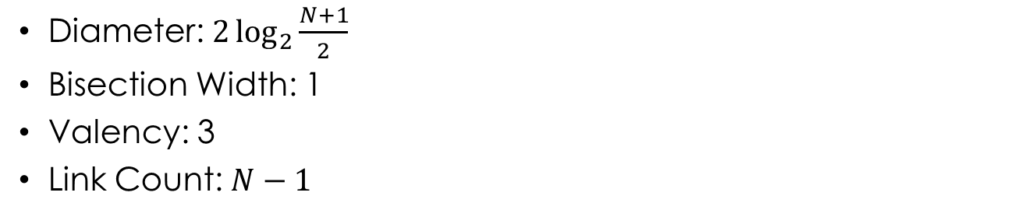
Recap: Thin tree topology
N=7
Diameter: $2\log_{2}{\frac{N+1}{2}}$
Bisection Width: 1
Valency: 3
Link Count: $N−1$
A thin tree has very nice properties, except that the bisection width is very low.
A fat tree deals with this problem.
(any tree structure with N nodes
will have N-1 edges!)
Notes:
Link Count (L) calculation:
Consider only “downwards” connections, to avoid duplicates.
If each node made 2, L=2N
But the (N+1)/2 leaf nodes don’t make any, so L = 2N-2*(N+1)/2 = 2N-N-1 = N-1

Slide 25
Fat tree
Start with a normal thin tree:
As you go up each level in the tree, double the number of links (or their bandwidth).

Slide 26
Fat tree
Start with a normal thin tree:
As you go up each level in the tree, double the number of links (or their bandwidth).

Slide 27
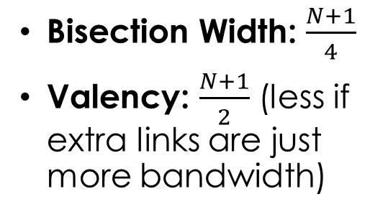
Fat tree
Start with a normal thin tree:
Bisection Width: $\frac{N+1}{4}$
Valency: $\frac{N+1}{2}$ (less if extra links are just more bandwidth)
As you go up each level in the tree, double the number of links (or their bandwidth).
Notes:
2^(Log(N+1)-1) = 0.5*N

Slide 28
Indirect networks
So far we’ve assumed that every node in the network is a full node (i.e. a computer) – direct network.
The advantage of this is that the network interface is closer to the CPU / RAM → faster.
The disadvantage is that for high valency each machine needs many network interfaces.
In an indirect network, the actual network topology is made up of dedicated switching devices.

Slide 29
Indirect Fat tree
Switches
Compute nodes
Notes:
2^(Log(N+1)-1) = 0.5*N

Slide 30
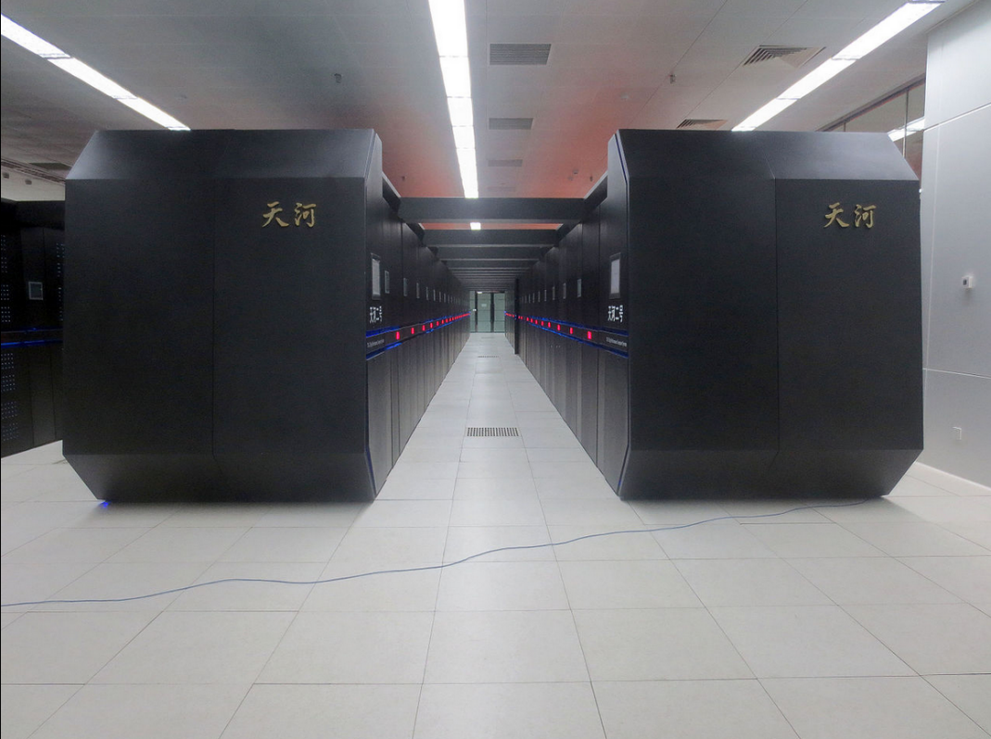
A very Fat tree
Tianhe-2 (Chinese National Supercomputer Centre, Guangzhou)
16,000 nodes (each with 2x Xeon CPUs, 3x Xeon Phis = ~3 million cores!)
Indirect fat tree topology.
Fastest computer in the world in 2015, now 2nd.

Slide 31
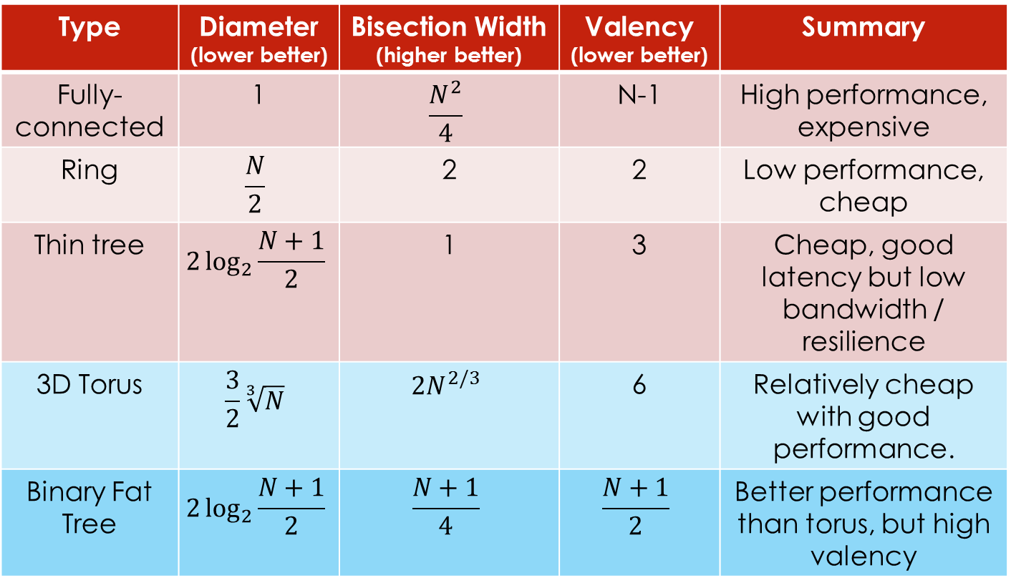
summary
Type | Diameter (lower better) | Bisection Width (higher better) | Valency (lower better) | Summary
Fully-connected | 1 | $$\frac{N^{2}}{4}$$ | N-1 | High performance, expensive
Ring | $$\frac{N}{2}$$ | 2 | 2 | Low performance, cheap
Thin tree | $$2\log_{2}{\frac{N+1}{2}}$$ | 1 | 3 | Cheap, good latency but low bandwidth / resilience
3D Torus | $$\frac{3}{2}\sqrt[3]{N}$$ | $$2N^{2/3}$$ | 6 | Relatively cheap with good performance.
Binary Fat Tree | $$2\log_{2}{\frac{N+1}{2}}$$ | $$\frac{N+1}{4}$$ | $$\frac{N+1}{2}$$ | Better performance than torus, but high valency

Slide 32
Today’s lecture
More connection topologies for supercomputing.
Torus networks
Fat-tree networks
Class test revision (requested topics):
GPU memory types
Calculating occupancy
CGMA
Speed-up, efficiency, Amdahl and Gustofson’s laws

Slide 33
GPU Memories: Summary
Registers: fastest, accessible by a single thread.
L1 Cache / Shared Memory: located in an SM, shared between threads in that SM, extremely fast.
Uniform Cache: Similar to L1 – will see difference shortly.
L2 Cache: Shared between all SMs, much faster than RAM but slower than L1.
Global Memory (RAM): Big & slow, shared between all SMs. Only memory we can read/write from host (cudaMemcpy).

Slide 34
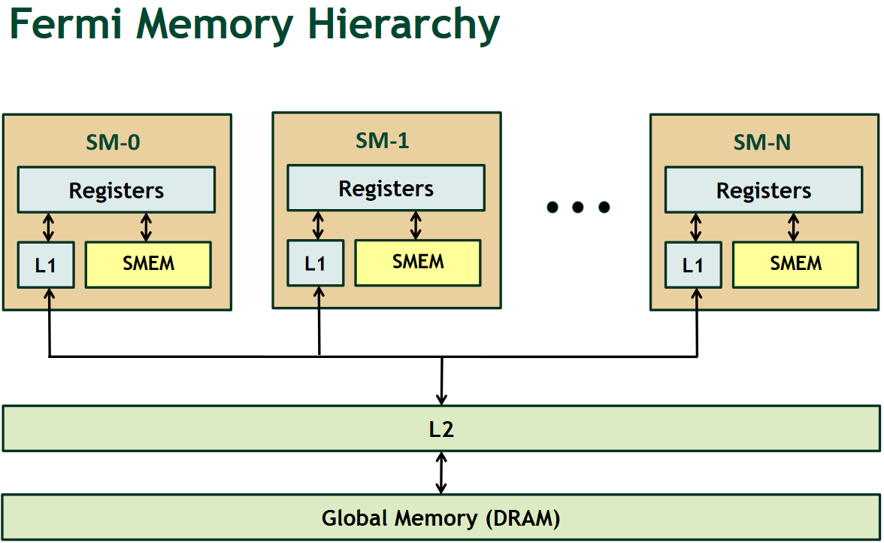
Caching in GPUs
http://on-demand.gputechconf.com/gtc-express/2011/presentations/register_spilling.pdf

Slide 35
L1 and l2 cache
Firstly, you don’t need to worry about the L1 and L2 caches too much.
The GPU automatically takes care of caching frequently used data in these.
Just be aware that each SM has its own L1 cache, but L2 cache is shared between all of them.
If each block works on different data, there may not be enough L2 cache to store every block’s data, hurting performance.

Slide 36

GPU Memories: Summary
Registers: fastest, accessible by a single thread.
L1 Cache / Shared Memory: located in an SM, shared between threads in that SM, extremely fast.
Uniform Cache: Similar to L1 – will see difference shortly.
L2 Cache: Shared between all SMs, much faster than RAM but slower than L1.
Global Memory (RAM): Big & slow, shared between all SMs. Only memory we can read/write from host (cudaMemcpy).

Slide 37
Registers
Most local variables you create in kernels will be stored in registers.
__global__ void sinKernel() {
int globalId = blockIdx.x * blockDim.x + threadIdx.x;
Stored in a register.
There are two main exceptions:
Arrays where you access elements using a variable:
__global__ void sinKernel() {
int array[10];
for (int i = 0; i < 10; i++) array[i] = i;

Slide 38
Registers
Most local variables you create in kernels will be stored in registers.
__global__ void sinKernel() {
int globalId = blockIdx.x * blockDim.x + threadIdx.x;
Stored in a register.
There are two main exceptions:
Arrays where you access elements using a variable.
If you use more than the available register space (in Fermi: 63 registers / thread by default):
__global__ void sinKernel() {
int array[63];// In registers (if no variable indexing)
int extraInt; // Spilled into “local memory”

Slide 39
“Local” memory
Local variables from kernels that can’t be stored in registers get stored in a special region of global memory that can only be accessed by one thread.
As only 1 thread has access this is called local memory, even though it’s physically in global memory…
… obviously …
Global memory is slow, so you want to avoid this!
(although may not be disastrous if cached in L1/L2)

Slide 40
GPU Memories: Summary
Registers: fastest, accessible by a single thread.
L1 Cache / Shared Memory: located in an SM, shared between threads in that SM, extremely fast.
Uniform Cache: Similar to L1 – will see difference shortly.
L2 Cache: Shared between all SMs, much faster than RAM but slower than L1.
Global Memory (RAM): Big & slow, shared between all SMs. Only memory we can read/write from host (cudaMemcpy).

Slide 41
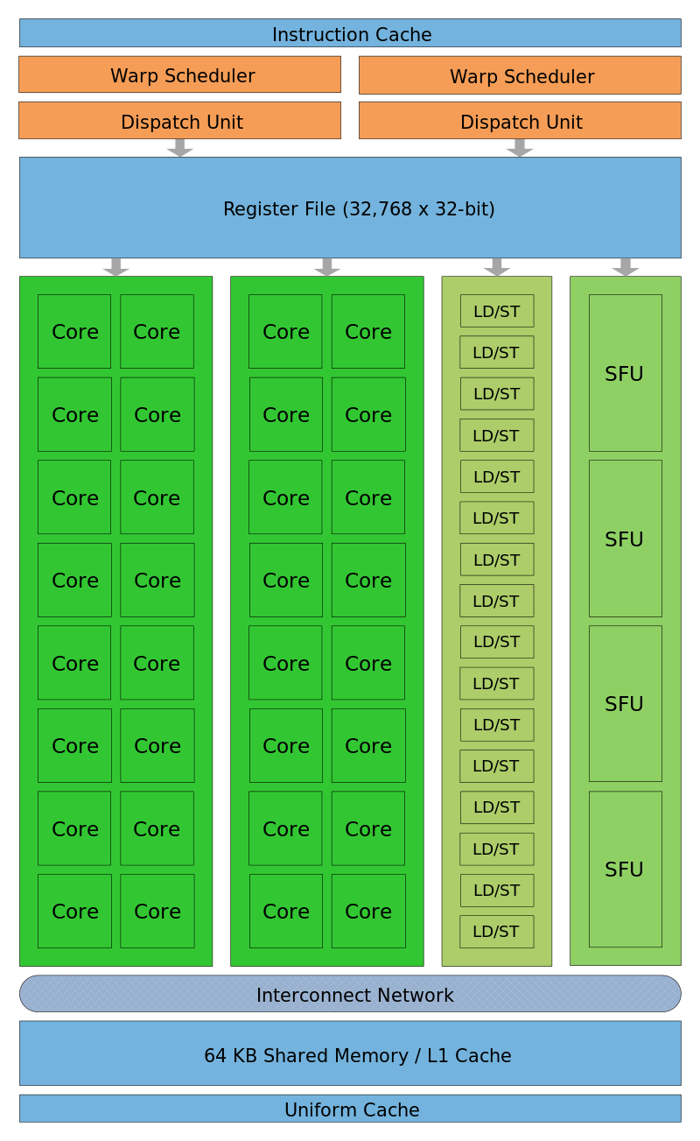
Uniform cache
The uniform cache is an on-chip (part of each SM) cache that is designed for broadcasting data.
If multiple threads access the same address in the uniform cache at the same time, the data is sent to them all simultaneously.
Threads can’t change the value of data in the uniform cache.

Slide 42
Constant memory
To take advantage of the uniform cache we need to specify that a particular variable in global memory can’t change.
Use the __constant__ modifier:
These variables will be stored in the device’s global memory, in a special area reserved for constant data.
When a thread accesses data from here, it will be cached in the uniform cache and optimized for broadcast reads.
__constant__ float d_constArray[10];
__constant__ float d_constValue;
Notes:
Note that you can still copy data to a device variable marked __constant__ from the host, but you can’t modify it in the kernel.

Slide 43
GPU Memories: Summary
Registers: fastest, accessible by a single thread.
L1 Cache / Shared Memory: located in an SM, shared between threads in that SM, extremely fast.
Uniform Cache: Similar to L1 – will see difference shortly.
L2 Cache: Shared between all SMs, much faster than RAM but slower than L1.
Global Memory (RAM): Big & slow, shared between all SMs. Only memory we can read/write from host (cudaMemcpy).

Slide 44
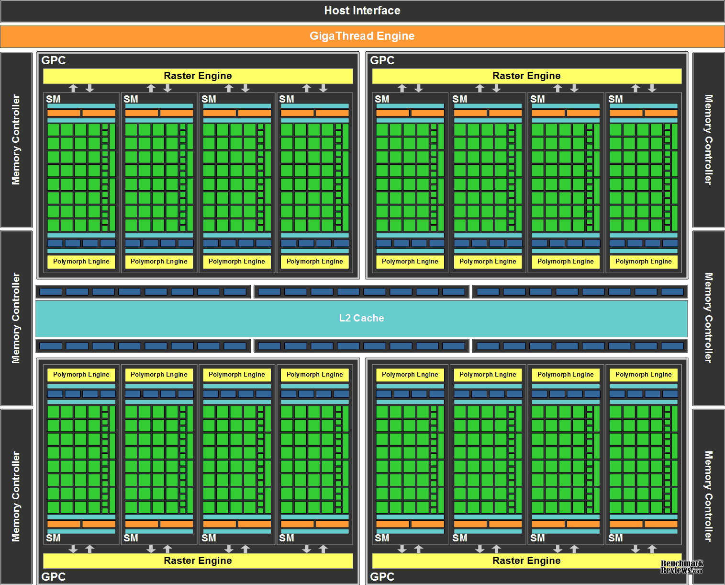
Global memory
Global memory is huge but relatively slow.
We can copy between main RAM and the GPU’s global memory using cudaMemcpy.
This is the slowest type of transfer, but can be sped up by pinning data in RAM.

Slide 45
Global memory
To allocate global memory:
Static: __device__ float d_array[10];
Dynamic: cudaMalloc(&d_array, 10*sizeof(float));
To access it from the host code:
cudaMemcpyToSymbol
cudaMemcpyFromSymbol
cudaMemcpy
And access it in a kernel (static allocation here):
__global__ void sinKernel() {
int globalId = blockIdx.x * blockDim.x + threadIdx.x;
if (globalId < n) {
d_result[globalId] = sin(d_input[n]);
...
Notes:
Remember we need to pass pointers to the allocated memory as parameters to the kernel if we dynamically allocate the memory using cudaMalloc.

Slide 46
Global memory
Global memory has a few smaller regions that have specific uses:
Constant memory: if we put variables here, they will be cached for broadcast in the SMs’ uniform caches.
Local memory: any of a thread’s local variables that can’t go in registers go here.
Global Memory
Constant Memory
Local Memory

Slide 47
GPU Memories: Summary
Registers: fastest, accessible by a single thread.
L1 Cache / Shared Memory: located in an SM, shared between threads in that SM, extremely fast.
Uniform Cache: Similar to L1 – will see difference shortly.
L2 Cache: Shared between all SMs, much faster than RAM but slower than L1.
Global Memory (RAM): Big & slow, shared between all SMs. Only memory we can read/write from host (cudaMemcpy).

Slide 48
Shared memory
The most interesting type of memory!
All threads running on a SM have access to it.
As fast as L1.
But: you (the programmer) are in charge of how it’s used.
If you use it cleverly, you can get big increases in performance.

Slide 49
Shared memory
A variable with the __shared__ modifier has its memory allocated in the streaming multiprocessors’ shared memory area.
Each block has a separate copy of any __shared__ variables.
All threads in a block can access their block’s copy of the shared variables, but not other blocks’ copies.

Slide 50

Shared memory
Shared memory can be used to allow threads within a block to communicate with each other very quickly.
Common pattern is when all threads in a block need the same chunk of global memory:
Each thread loads a bit of the global data into shared memory (happens in parallel).
Library metaphor: study group makes a list of books they need, everyone fetches a book from global memory (the shelves) and puts it on a shared desk.

Slide 51
GPU Memories: Summary
Registers: fastest, accessible by a single thread.
L1 Cache / Shared Memory: located in an SM, shared between threads in that SM, extremely fast.
Uniform Cache: Similar to L1 – will see difference shortly.
L2 Cache: Shared between all SMs, much faster than RAM but slower than L1.
Global Memory (RAM): Big & slow, shared between all SMs. Only memory we can read/write from host (cudaMemcpy).

Slide 52
Today’s lecture
More connection topologies for supercomputing.
Torus networks
Fat-tree networks
Class test revision (requested topics):
GPU memory types
Calculating occupancy
CGMA
Speed-up, efficiency, Amdahl and Gustofson’s laws

Slide 53
Occupancy
Occupancy refers to how many blocks can be resident in a streaming multiprocessor at once.
It is always a whole number – you can’t have half a block assigned to a SM!
Low occupancy can limit performance.
Fewer warps resident in an SM means more chance that all of them are waiting, which means the SM is idle.

Slide 54
Calculating Occupancy
There are three main things that can limit occupancy:
The hard blocks per SM limit.
The number of threads in a block.
The amount of shared memory used by a block.
You need to calculate the occupancy limit according to each of these constraints, then take the minimum.

Slide 55
Calculating Occupancy
There are three main things that can limit occupancy:
The hard blocks per SM limit.
The number of threads in a block.
The amount of shared memory used by a block.
You need to calculate the occupancy limit according to each of these constraints, then take the minimum.

Slide 56
Blocks per SM limit
Every compute capability specifies a maximum number of blocks that can be resident in a SM at once:
Occupancy can never be higher than this number!

Slide 57
Calculating Occupancy
There are three main things that can limit occupancy:
The hard blocks per SM limit.
The number of threads in a block.
The amount of shared memory used by a block.
You need to calculate the occupancy limit according to each of these constraints, then take the minimum.

Slide 58
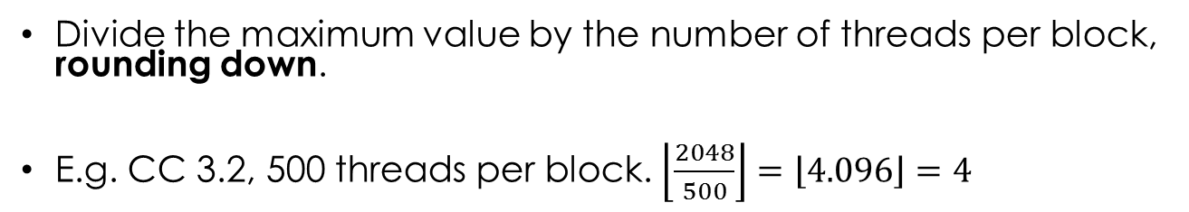
Number of threads in a block
First calculate how many threads each block contains.
Multiply the dimensions together, e.g. 10x10x5 = 500
Look at “max. number of resident threads / MP” value.
Divide the maximum value by the number of threads per block, rounding down.
E.g. CC 3.2, 500 threads per block. $\left\lfloor \frac{2048}{500}\right\rfloor =\left\lfloor 4.096\right\rfloor =4$

Slide 59
Calculating Occupancy
There are three main things that can limit occupancy:
The hard blocks per SM limit.
The number of threads in a block.
The amount of shared memory used by a block.
You need to calculate the occupancy limit according to each of these constraints, then take the minimum.

Slide 60
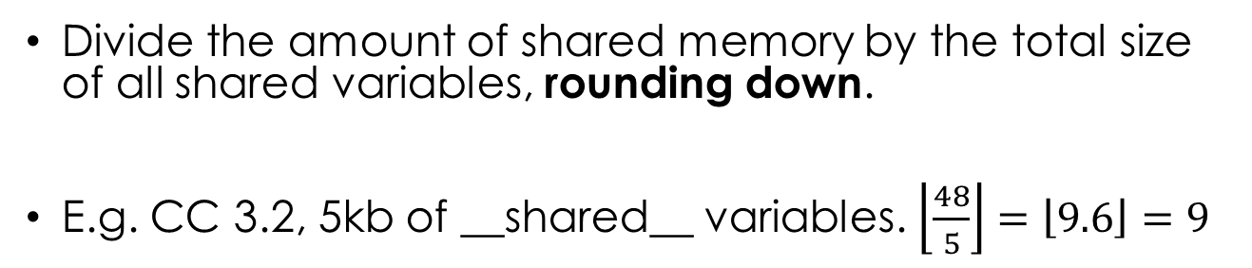
Shared memory
Each block has its own copy of all __shared__ variables.
Each SM only has a limited amount of shared memory:
Divide the amount of shared memory by the total size of all shared variables, rounding down.
E.g. CC 3.2, 5kb of __shared__ variables. $\left\lfloor \frac{48}{5}\right\rfloor =\left\lfloor 9.6\right\rfloor =9$

Slide 61
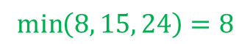
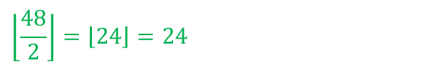
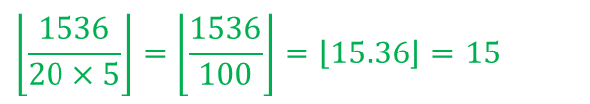
example
An application uses blocks of 20x5 threads, and each block uses 2KB of shared memory.
On a CC 2.x GPU, what’s the occupancy limit according to:
The hard block count limit?
The number of threads per SM limit?
The shared memory per SM limit?
What’s the overall occupancy limit?
8
$$\left\lfloor \frac{1536}{20×5}\right\rfloor =\left\lfloor \frac{1536}{100}\right\rfloor =\left\lfloor 15.36\right\rfloor =15$$
$$\left\lfloor \frac{48}{2}\right\rfloor =\left\lfloor 24\right\rfloor =24$$
$$\min\left(8, 15, 24\right)=8$$

Slide 62
Today’s lecture
More connection topologies for supercomputing.
Torus networks
Fat-tree networks
Class test revision (requested topics):
GPU memory types
Calculating occupancy
CGMA
Speed-up, efficiency, Amdahl and Gustofson’s laws

Slide 63
CGMA: What’s a fLOP?
$$CGMA=\frac{\#floating point operations}{\# 32bit values read from or written to global memory}$$
float or int values
For the purposes of the class test, one floating point operation is either:
Adding/subtracting/dividing/multiplying together two floating point values.
Calling a basic maths function: sin, cos, exp, log.
If the code involves different functions, you will be told how many FLOPs calling the function uses.

Slide 64
CGMA: What’s a GMA?
$$CGMA=\frac{\#floating point operations}{\# 32bit values read from or written to global memory}$$
float or int values
If an array is declared with __device__ or allocated with cudaMalloc then it is stored in global memory.
All reads/writes from/to elements in such an array count towards the bottom (“GMA”) part of the ratio.
Ignore automatic caching (in L1/L2) for this!

Slide 65
CGMA
$$CGMA=\frac{\#floating point operations}{\# 32bit values read from or written to global memory}$$
float or int values
Arrays declared __shared__ will be stored in shared memory → accesses don’t count towards “GMA”.
Arrays declared __constant__ will be kept in the uniform cache → accesses don’t count towards “GMA”.
Arrays created in a kernel function will be kept in registers → accesses don’t count towards “GMA”.

Slide 66
CGMA Example
__device__ float data[BLOCK_SIZE*NUM_BLOCKS];
__shared__ float sharedMem[BLOCK_SIZE];
__global__ void myKernel()
{
int globalId = blockIdx.x * blockDim.x + threadIdx.x;
sharedMem[threadIdx.x] = data[globalId];
__syncthreads();
float myTotal = 0.0f;
for (int i = 0; i < BLOCK_SIZE; i++) {
myTotal += sin(sharedMem[threadIdx.x] * sharedMem[i]);
}
data[globalId] = myTotal;
}
Which lines do floating point computations?

Slide 67
CGMA Example
__device__ float data[BLOCK_SIZE*NUM_BLOCKS];
__shared__ float sharedMem[BLOCK_SIZE];
__global__ void myKernel()
{
int globalId = blockIdx.x * blockDim.x + threadIdx.x;
sharedMem[threadIdx.x] = data[globalId];
__syncthreads();
float myTotal = 0.0f;
for (int i = 0; i < BLOCK_SIZE; i++) {
myTotal += sin(sharedMem[threadIdx.x] * sharedMem[i]);
}
data[globalId] = myTotal;
}
How many operations?

Slide 68
CGMA Example
__device__ float data[BLOCK_SIZE*NUM_BLOCKS];
__shared__ float sharedMem[BLOCK_SIZE];
__global__ void myKernel()
{
int globalId = blockIdx.x * blockDim.x + threadIdx.x;
sharedMem[threadIdx.x] = data[globalId];
__syncthreads();
float myTotal = 0.0f;
for (int i = 0; i < BLOCK_SIZE; i++) {
myTotal += sin(sharedMem[threadIdx.x] * sharedMem[i]);
}
data[globalId] = myTotal;
}
3: sin, multiply, add… but in a loop so BLOCK_SIZE*3 in total

Slide 69
CGMA Example
data is the only variable stored in global memory.
__device__ float data[BLOCK_SIZE*NUM_BLOCKS];
__shared__ float sharedMem[BLOCK_SIZE];
__global__ void myKernel()
{
int globalId = blockIdx.x * blockDim.x + threadIdx.x;
sharedMem[threadIdx.x] = data[globalId];
__syncthreads();
float myTotal = 0.0f;
for (int i = 0; i < BLOCK_SIZE; i++) {
myTotal += sin(sharedMem[threadIdx.x] * sharedMem[i]);
}
data[globalId] = myTotal;
}
Which lines read or write from or to global memory?

Slide 70
CGMA Example
__device__ float data[BLOCK_SIZE*NUM_BLOCKS];
__shared__ float sharedMem[BLOCK_SIZE];
__global__ void myKernel()
{
int globalId = blockIdx.x * blockDim.x + threadIdx.x;
sharedMem[threadIdx.x] = data[globalId];
__syncthreads();
float myTotal = 0.0f;
for (int i = 0; i < BLOCK_SIZE; i++) {
myTotal += sin(sharedMem[threadIdx.x] * sharedMem[i]);
}
data[globalId] = myTotal;
}
Read a float
Write a float
So each thread does two global memory accesses.

Slide 71
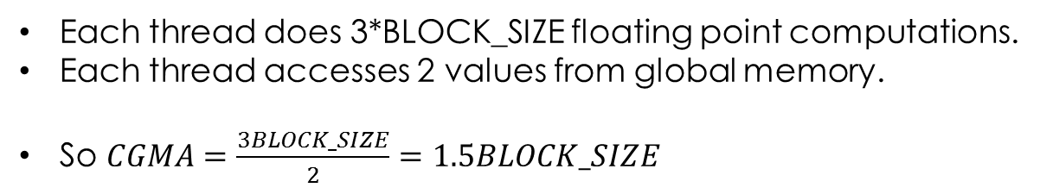
CGMA Example
__device__ float data[BLOCK_SIZE*NUM_BLOCKS];
__shared__ float sharedMem[BLOCK_SIZE];
__global__ void myKernel()
{
int globalId = blockIdx.x * blockDim.x + threadIdx.x;
sharedMem[threadIdx.x] = data[globalId];
__syncthreads();
float myTotal = 0.0f;
for (int i = 0; i < BLOCK_SIZE; i++) {
myTotal += sin(sharedMem[threadIdx.x] * sharedMem[i]);
}
data[globalId] = myTotal;
}
Each thread does 3*BLOCK_SIZE floating point computations.
Each thread accesses 2 values from global memory.
So $CGMA=\frac{3BLOCK_SIZE}{2}=1.5BLOCK_SIZE$

Slide 72
CGMA: By thread or by block?
When you calculate the CGMA ratio you have two options for what to count:
Count the number of FLOPs and memory accesses that each thread does, or
Count the number of FLOPs and memory accesses that each block does.
If every thread in a block does the same thing (same # of FLOPs / GMAs) then you can count per thread.
But if different threads do different things, you need to consider the block as a whole.

Slide 73
another Example
__device__ float data[BLOCK_SIZE*NUM_BLOCKS];
__global__ void myKernel()
{
int globalId = blockIdx.x * blockDim.x + threadIdx.x;
if ((globalId % 2) == 0) { // Even threads
data[globalId] = sin(data[globalId]);
} else { // Odd threads
data[globalId] = 2 * sin(data[globalId]);
}
}
Which lines do floating point computations?

Slide 74
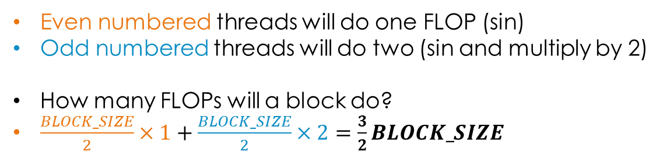
another Example
__device__ float data[BLOCK_SIZE*NUM_BLOCKS];
__global__ void myKernel()
{
int globalId = blockIdx.x * blockDim.x + threadIdx.x;
if ((globalId % 2) == 0) { // Even threads
data[globalId] = sin(data[globalId]);
} else { // Odd threads
data[globalId] = 2 * sin(data[globalId]);
}
}
Even numbered threads will do one FLOP (sin)
Odd numbered threads will do two (sin and multiply by 2)
How many FLOPs will a block do?
$\frac{BLOCK_SIZE}{2}×1+\frac{BLOCK_SIZE}{2}×2=\frac{3}{2}BLOCK_SIZE$

Slide 75
another Example
__device__ float data[BLOCK_SIZE*NUM_BLOCKS];
__global__ void myKernel()
{
int globalId = blockIdx.x * blockDim.x + threadIdx.x;
if ((globalId % 2) == 0) { // Even threads
data[globalId] = sin(data[globalId]);
} else { // Odd threads
data[globalId] = 2 * sin(data[globalId]);
}
}
Which lines do global memory accesses?

Slide 76
another Example
__device__ float data[BLOCK_SIZE*NUM_BLOCKS];
__global__ void myKernel()
{
int globalId = blockIdx.x * blockDim.x + threadIdx.x;
if ((globalId % 2) == 0) { // Even threads
data[globalId] = sin(data[globalId]);
} else { // Odd threads
data[globalId] = 2 * sin(data[globalId]);
}
}
All threads will do 2 GMAs: one read and one write.
So in total a block will do 2 * BLOCK_SIZE.

Slide 77
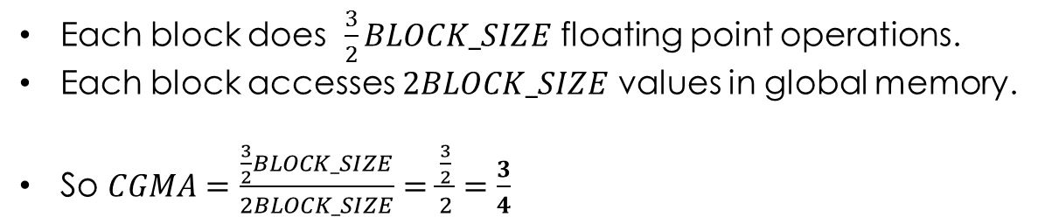
another Example
__device__ float data[BLOCK_SIZE*NUM_BLOCKS];
__global__ void myKernel()
{
int globalId = blockIdx.x * blockDim.x + threadIdx.x;
if ((globalId % 2) == 0) { // Even threads
data[globalId] = sin(data[globalId]);
} else { // Odd threads
data[globalId] = 2 * sin(data[globalId]);
}
}
Each block does $\frac{3}{2}BLOCK_SIZE$ floating point operations.
Each block accesses $2BLOCK_SIZE$ values in global memory.
So $CGMA=\frac{\frac{3}{2}BLOCK_SIZE}{2BLOCK_SIZE}=\frac{\frac{3}{2}}{2}=\frac{3}{4}$

Slide 78
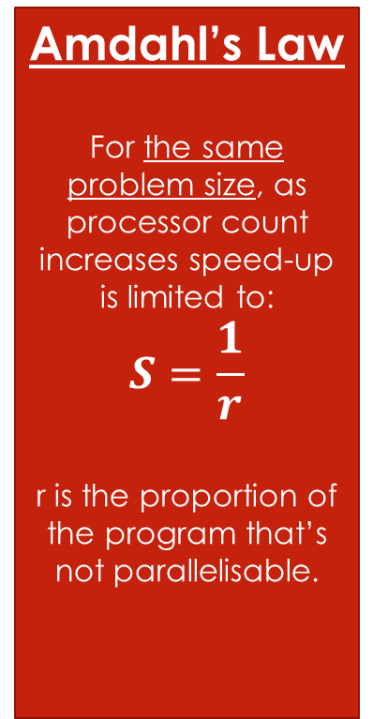
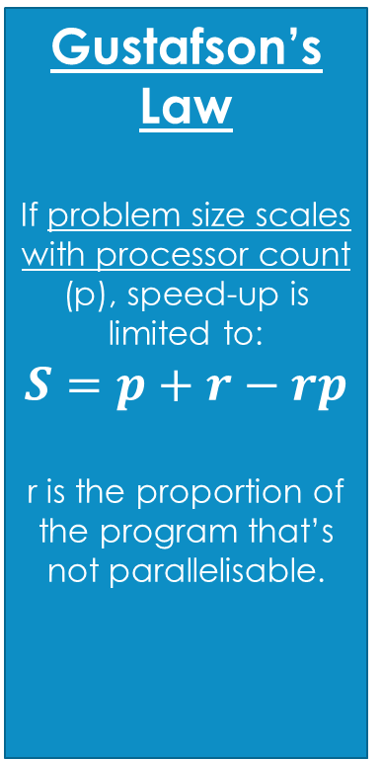
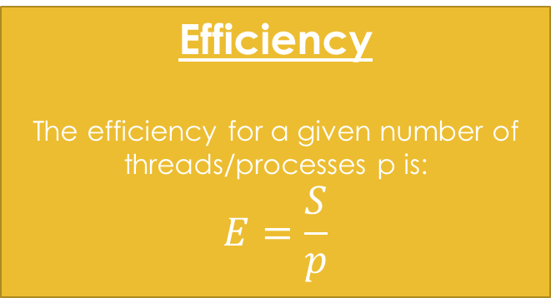
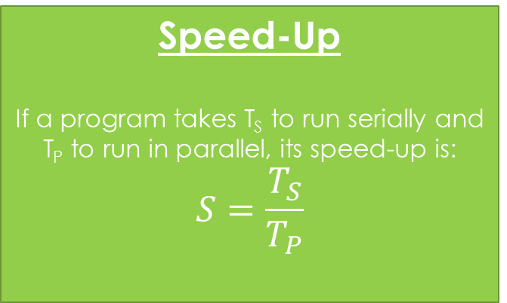
Speed-up and efficiency
For this you need to learn four formulas:
Speed-Up
If a program takes T_{S} to run serially and T_{P} to run in parallel, its speed-up is:
$$S=\frac{T_{S}}{T_{P}}$$
Amdahl’s Law
For the same problem size, as processor count increases speed-up is limited to:
$$S=\frac{1}{r}$$
r is the proportion of the program that’s not parallelisable.
Gustafson’s Law
If problem size scales with processor count (p), speed-up is limited to:
$$S=p+r−rp$$
r is the proportion of the program that’s not parallelisable.
Efficiency
The efficiency for a given number of threads/processes p is:
$$E=\frac{S}{p}$$

Slide 79
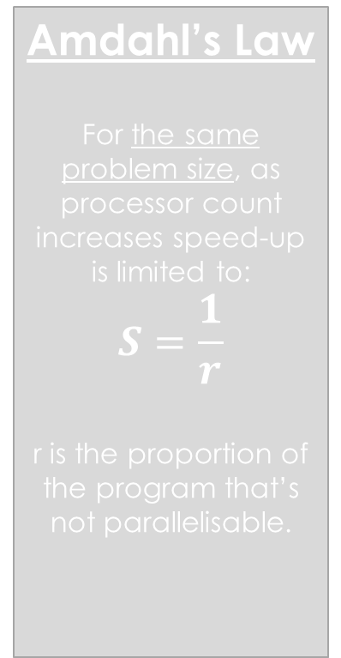
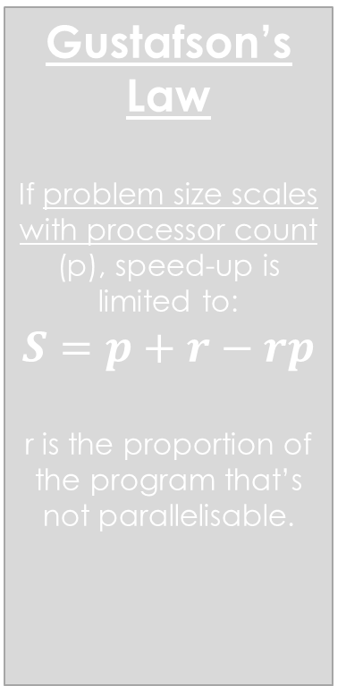
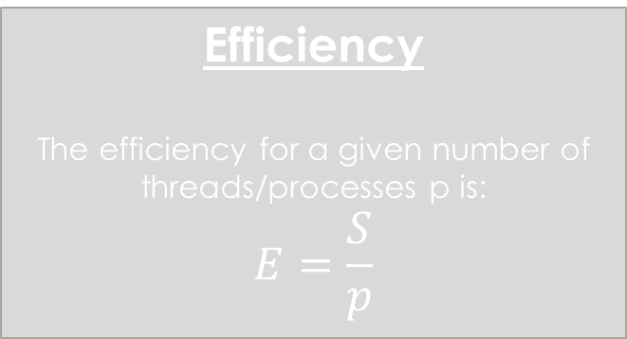
Speed-up and efficiency
For this you need to learn four formulas:
Speed-Up
If a program takes T_{S} to run serially and T_{P} to run in parallel, its speed-up is:
$$S=\frac{T_{S}}{T_{P}}$$
Amdahl’s Law
For the same problem size, as processor count increases speed-up is limited to:
$$S=\frac{1}{r}$$
r is the proportion of the program that’s not parallelisable.
Gustafson’s Law
If problem size scales with processor count (p), speed-up is limited to:
$$S=p+r−rp$$
r is the proportion of the program that’s not parallelisable.
Efficiency
The efficiency for a given number of threads/processes p is:
$$E=\frac{S}{p}$$

Slide 80
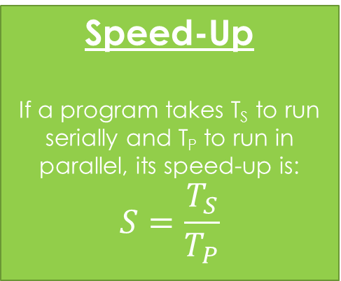
Speed-up
Speed-Up
If a program takes T_{S} to run serially and T_{P} to run in parallel, its speed-up is:
$$S=\frac{T_{S}}{T_{P}}$$
Will generally continue to increase as the number of processors increases (but upper bound is limited by Amdahl’s law).
A program takes 12s to run serially, 6s to run with two processors, 4s to run with four processors, 3s to run with eight.
What is the speed-up for p=2, 4 and 8?
Notes:
S(2) = 12/6 = 2
S(4) = 12/4 = 3
S(8) = 12/3 = 4

Slide 81
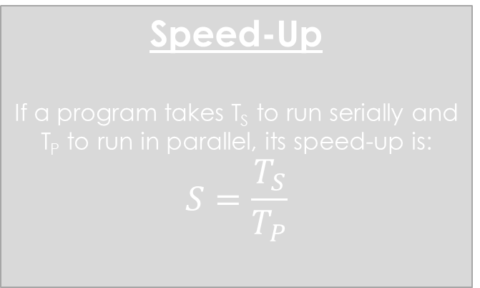
Speed-up and efficiency
For this you need to learn four formulas:
Speed-Up
If a program takes T_{S} to run serially and T_{P} to run in parallel, its speed-up is:
$$S=\frac{T_{S}}{T_{P}}$$
Amdahl’s Law
For the same problem size, as processor count increases speed-up is limited to:
$$S=\frac{1}{r}$$
r is the proportion of the program that’s not parallelisable.
Gustafson’s Law
If problem size scales with processor count (p), speed-up is limited to:
$$S=p+r−rp$$
r is the proportion of the program that’s not parallelisable.
Efficiency
The efficiency for a given number of threads/processes p is:
$$E=\frac{S}{p}$$

Slide 82
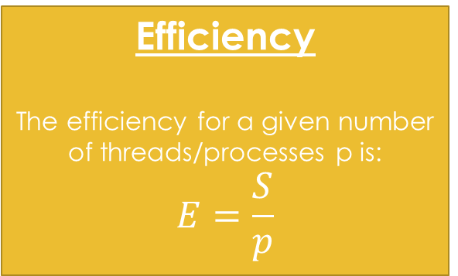
Efficiency
Efficiency
The efficiency for a given number of threads/processes p is:
$$E=\frac{S}{p}$$
Shows how much each processor is contributing to the speed-up. Will generally tend to 0 as p→∞ (diminishing returns).
A program takes 12s to run serially, 6s to run with two processors, 4s to run with four processors, 3s to run with eight.
What is the efficiency for p=2, 4 and 8?
Notes:
E(2) = 2/2 = 1
E(4) = ¾ = 0.75
E(8) = 4/8 = 0.5

Slide 83
Speed-up and efficiency
For this you need to learn four formulas:
Speed-Up
If a program takes T_{S} to run serially and T_{P} to run in parallel, its speed-up is:
$$S=\frac{T_{S}}{T_{P}}$$
Amdahl’s Law
For the same problem size, as processor count increases speed-up is limited to:
$$S=\frac{1}{r}$$
r is the proportion of the program that’s not parallelisable.
Gustafson’s Law
If problem size scales with processor count (p), speed-up is limited to:
$$S=p+r−rp$$
r is the proportion of the program that’s not parallelisable.
Efficiency
The efficiency for a given number of threads/processes p is:
$$E=\frac{S}{p}$$

Slide 84
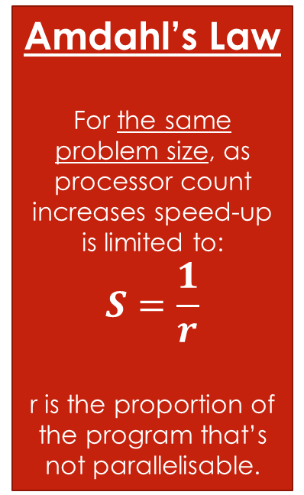
AMDAHL’s LAW
Amdahl’s Law
For the same problem size, as processor count increases speed-up is limited to:
$$S=\frac{1}{r}$$
r is the proportion of the program that’s not parallelisable.
Gives a limit to how fast you can solve the same problem by adding extra processors.
10% of a given program can’t be parallelised. If the program is run on one processor it takes 5s. According to Amdahl’s law, what is the fastest time the program can possibly run in, no matter the processor count?
Notes:
r=0.1, so maximum speed-up =1/r=10.
10 = T_S / T_P = 5 / T_P so T_P=5/10 = 0.5s

Slide 85
Speed-up and efficiency
For this you need to learn four formulas:
Speed-Up
If a program takes T_{S} to run serially and T_{P} to run in parallel, its speed-up is:
$$S=\frac{T_{S}}{T_{P}}$$
Amdahl’s Law
For the same problem size, as processor count increases speed-up is limited to:
$$S=\frac{1}{r}$$
r is the proportion of the program that’s not parallelisable.
Gustafson’s Law
If problem size scales with processor count (p), speed-up is limited to:
$$S=p+r−rp$$
r is the proportion of the program that’s not parallelisable.
Efficiency
The efficiency for a given number of threads/processes p is:
$$E=\frac{S}{p}$$

Slide 86
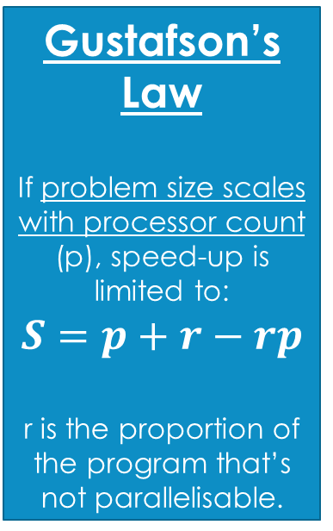
Gustafson’s law
Gustafson’s Law
If problem size scales with processor count (p), speed-up is limited to:
$$S=p+r−rp$$
r is the proportion of the program that’s not parallelisable.
Gives a limit to how fast you can solve the same problem by adding extra processors.
10% of a given program can’t be parallelised. Assuming the problem size is equal to the number of processors, what does Gustafson’s law say the maximum speed-up with 100 processors is?
Notes:
p=100, r=0.1
S = 100+0.1 – 0.1*100 = 90.1

Slide 87
Don’t panic; revise!
I’m not trying to catch anyone out in the test – I don’t do trick questions!
Take the time to go through the lecture slides and make sure everything’s clear – otherwise email me!
I will put some more practice questions and a list of what you need to learn online soon.
Remember: test is next Thursday, 1-3pm, FZB205 (downstairs)

Slide 88
Final lecture
There will be a lecture at the usual time on Thursday 15th December.
First half: general parallel program design, advanced CUDA topic.
Second half: Samantha Adams, Senior Scientific Software Engineer, The Met Office
Don’t skip it because the test is over – it may help for your coursework and should be very interesting!

